Slide 1

Image Processing Exercises
Hands-on session
Naomi Thiru
KU Leuven(SADL)

Slide 2
Table of contents
Image processing tools
Explore processing plugin and loading data
True and False Color composites: Exploring Band Combinations
Exploring spectral signatures
Image classification

Slide 3
Learning Objectives
At the end of the course the participants should be able to:
Work with the machine learning plugin in QGIS
Perform exploratory image analysis using band combinations
Understand a basic machine learning workflow
Prepare image classification results with symbology
Convertion of data from raster to vector formats

Slide 4
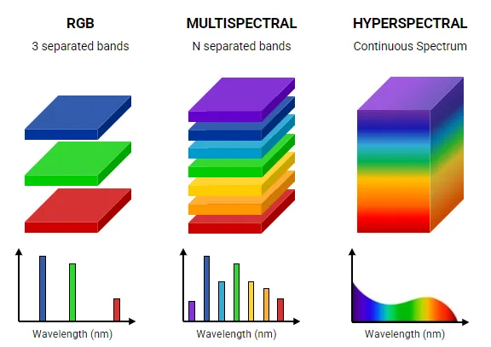
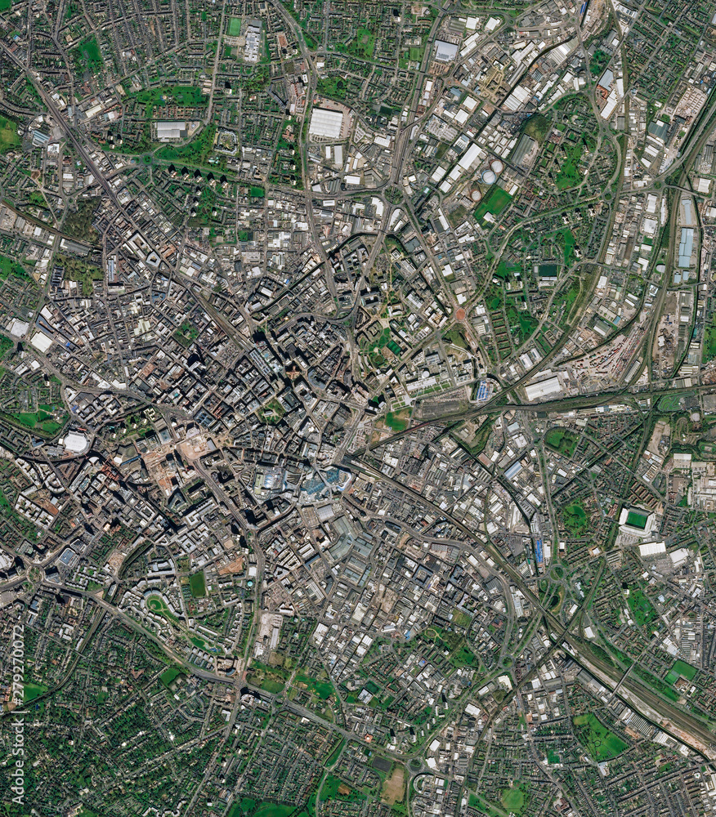
Image data

Slide 5
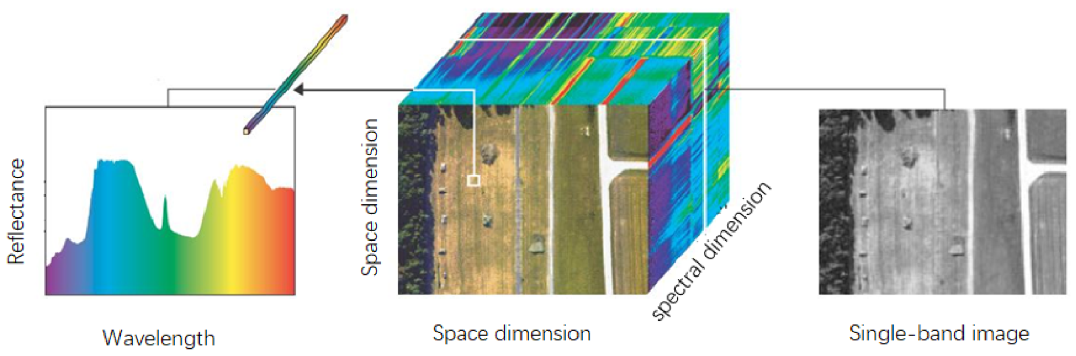
Hyperspectral Image cube

Slide 6
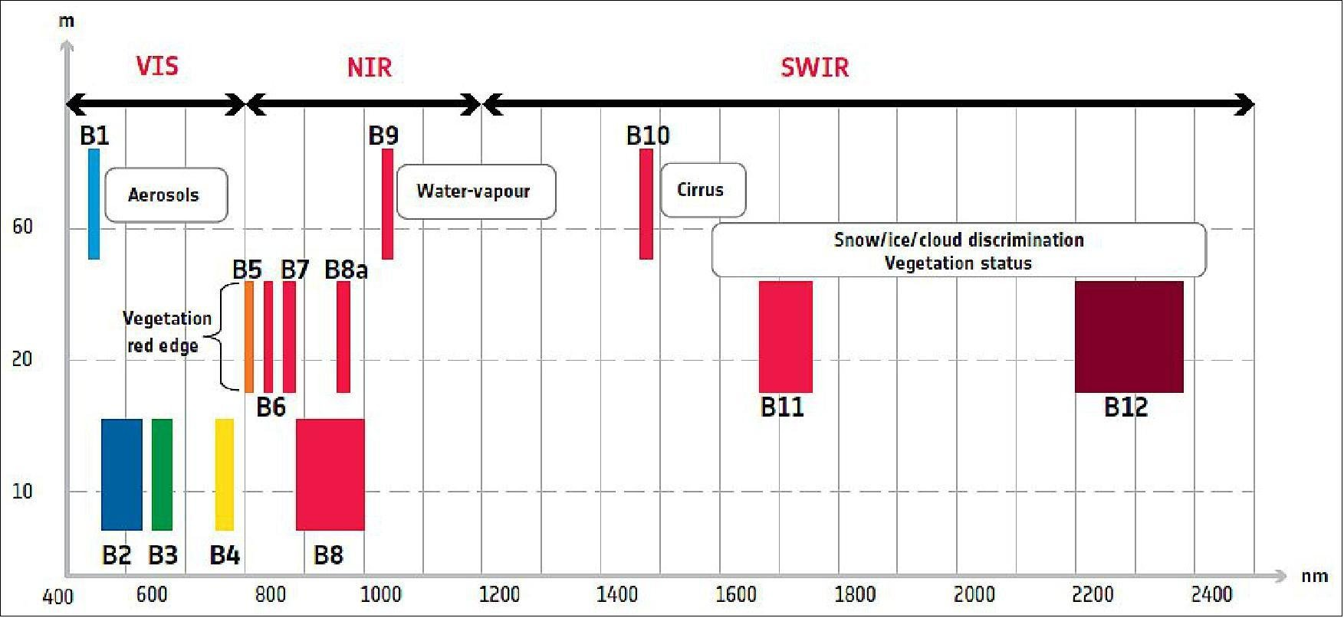
Bands across the Electromagnetic Spectrum

Slide 7
Image Processing Tools
Tools
ENVI- Popular proprietary software, used widely in industry
QGIS Plugins:-
En-Map Box – Open source, Regularly maintained
Python: Wide variety of libraries e.g. machine learning libraries, hyperspectral data libraries, geospatial libraries. Python is also incorporated into GIS software back-end.

Slide 8
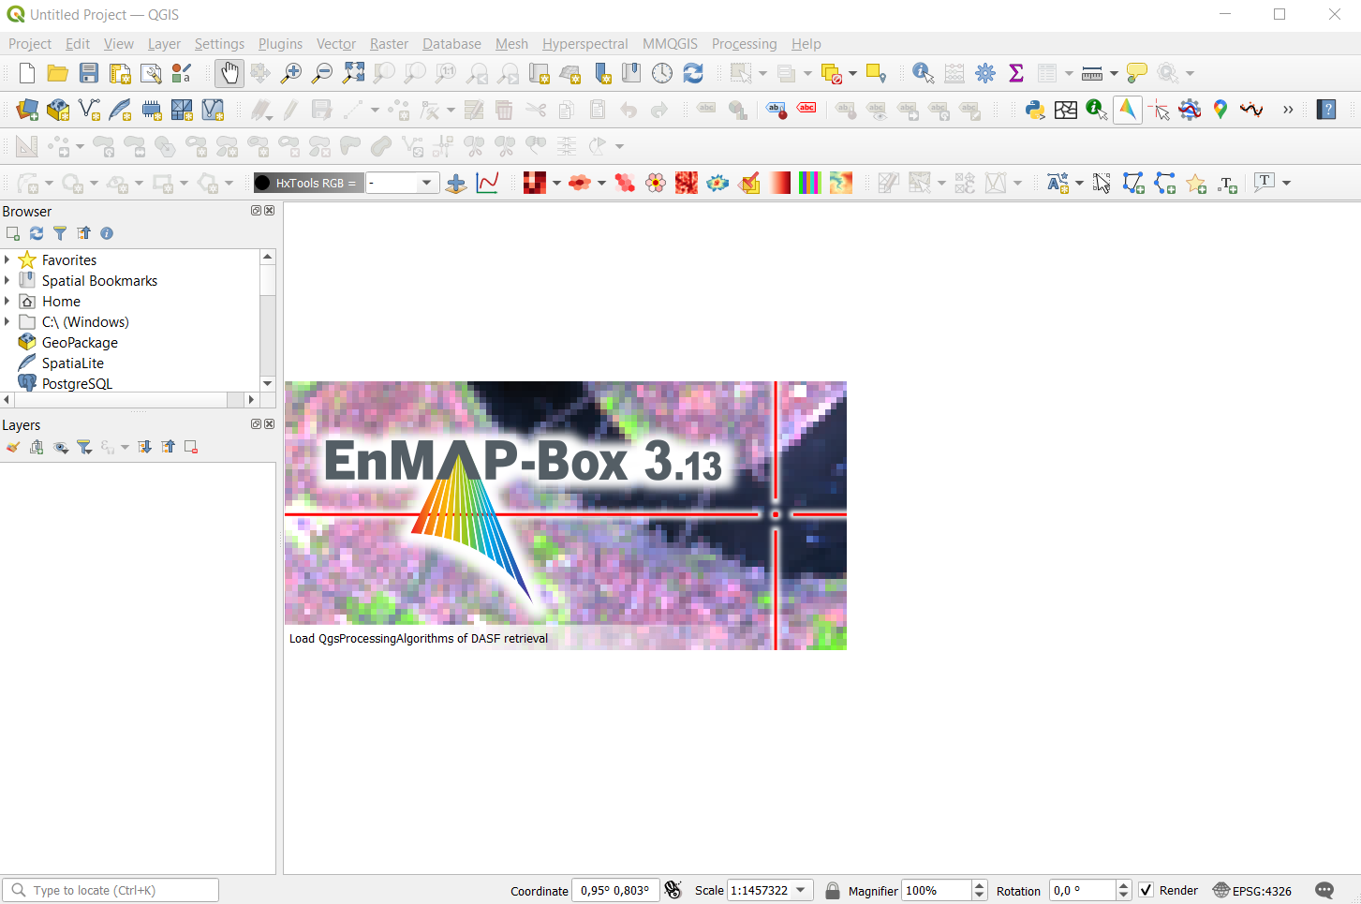
QGIS Plugins
Plugins built to add support for tasks as an extension of the software
Exercise: Install En-map Box
1. Menu bar – Plugins –Manage and Install Plugins
2. All → EnMap-Box 3
3. Install Plugin
4. Launch EnMap-Box

Slide 9
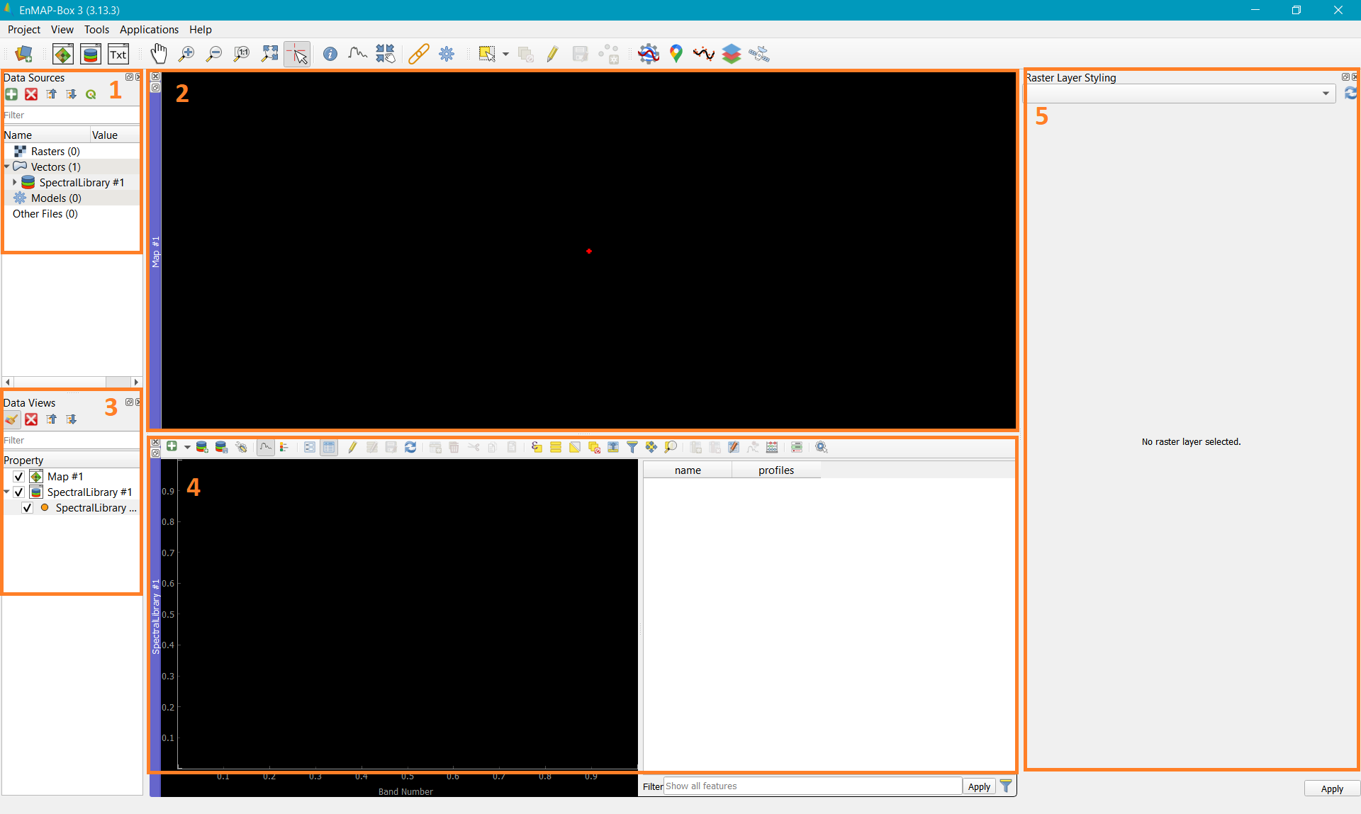
EnMAP-Box
Exercise: Open and explore EnMAP-Box
Data Sources
Data Views
Map View
Spectral profile view
Raster layer styling

Slide 10

Load data
Exercise: Load the hyperspectral data provided in the folder ‘data’ provided:
Rasters→”urban_industrial_zone.tif”
Data source →Add data source →(select image)→open
“urban_industrial_zone.tif”→right click→Open in new map→True color
350 bands, VNIR + SWIR, 377 to 2500 nm

Slide 11
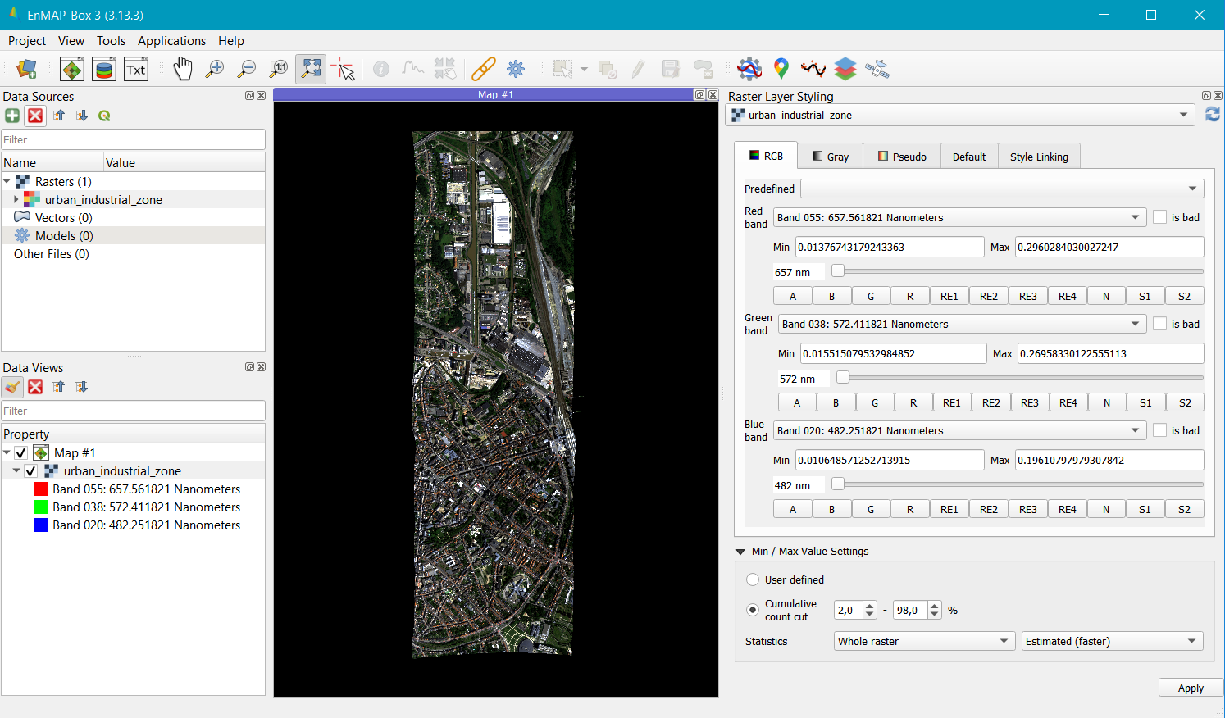

Slide 12
True and False Colour Composites
Band combinations in the SWIR and NIR band ranges can reveal different features in a landscape
Exercise: Test the following in the raster layer styling window;
Combination 1 (SWIR1, NIR, Blue): Useful for distinguishing man-made surfaces, vegetation, and water features.
Combination 2 (SWIR1-SWIR2-NIR): For better discrimination, adding a second SWIR band can enhance contrast between man-made surfaces like concrete, which has a stronger SWIR reflection, and asphalt, which remains relatively dark.
Combination 3 (NIR-Green-Red): A classic false-color combination that emphasizes vegetation, which can often be integrated within built-up areas, parks, or tree-lined streets. Vegetation will appear in bright tones, contrasting with urban materials.
Combination 4 (SWIR1-NIR-Green): With SWIR highlighting moisture content, this combination is effective for detecting green roofs, park areas, or vegetation along roadsides, even in dense urban areas. Helps in distinguishing different roof types, as materials like metal, shingles, and ceramic have unique spectral responses. SWIR1 is particularly sensitive to material composition and moisture content, while NIR can separate vegetated green roofs.
Combination 5 (SWIR1-Red-Green): SWIR and Red can help distinguish roofing materials with varying thermal or water absorption characteristics, while Green adds a layer of contrast for vegetation versus non-vegetated surfaces.

Slide 13

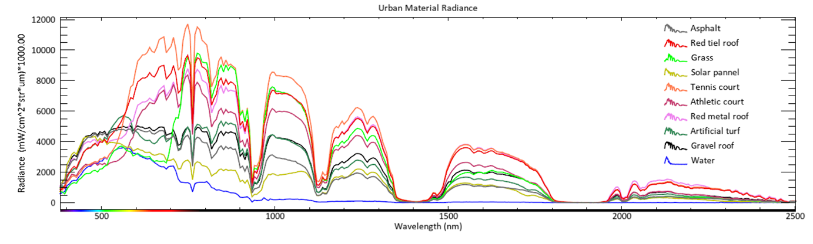
Spectral Viewer
Explore spectral signatures:
With the cursor , inspect signatures on the image “urban_industrial_zone.tif”
pixels across the wavelength
- The spectral data provides the training data for the classification model.

Slide 14
Image pre-processing
This is an important step to prepare an image for classification
Leads to better defined spectral features, prepare data for accurate and reliable classification, improve the quality of spectral information leading to better classification results. This includes;
Noise Reduction (e.g., destriping and denoising)
Dimensionality Reduction or Band Selection (to reduce data dimensionality)
Normalization or Resampling (for consistency across datasets)
Masking (optional, based on specific area of interest)
Outlier Detection (to remove spectral anomalies)
EXERCISE:
Perform dimensionality reduction using the FastICA algorithm
1. EnMAP-Box→Transformation→Fit FastICA → 10components
2. Raster layer with features → urban_industiaal_savgol.tif→save transformer
3. Transform raster layer→fill in raster layer and transformer→Save output raster

Slide 15
Image classification
Exercise: Perform image classification using RandomForest classification algorithm
Data: - Image: Rasters→“urban_industrial_zone.tif”/ Principal Components raster: “fastICA_10.tif”
- Training data: Vectors→“training_polygons.gpkg”
Add vector data to the map viewer, and place it above the image “urban_industrial_zone.tif”
Menu bar →Applications → Classification workflow
Load classification dataset; (Optional create own classification dataset)
Select RandomForestClassifier
Select raster layer with features, which is the .tif file used to create the classification dataset
Select folds for verification; Use 3 for this exercise
Save classified image
Generate classification report

Slide 16
Post processing
Image classification post-processing refers to the set of steps applied after a model has made predictions on an image. These steps refine the results, eliminating noise by removing/reducing ‘salt and pepper’ effect.
One method is applying a spatial mode filter, that assigns the most frequently occurring (mode) classification label within a defined spatial neighborhood to each pixel or segment.
Exercise:
-Processing toolbox → EnMAP-Box→Convolution,morphology and filtering →Spatial generic filter
-Use the following script: Vectors-”post_processing_script.txt”
from scipy.ndimage.filters import generic_filter
import numpy as np
from scipy.stats import mode
def filter_function(invalues):
invalues_mode = mode(invalues, axis=None, nan_policy='omit')
return invalues_mode[0]
function = lambda array: generic_filter(array, function=filter_function, size=3)

Slide 17
Vectorization
Vectorizing a classification raster refers to converting its pixel-based raster data into vector-based formats. This is valuable for:
Improved data storage and analysis
Efficient Data Storage and Analysis
Attribute Enrichment
Advanced Spatial Analysis
Interoperability
Exercise:
- Load building footprints data into QGIS, overlay onto the classified surface materials
- Geoprocessing tools→ Zonal statistics
- Statistics to calculate → select ‘majority’→ Save vector layer

Slide 18
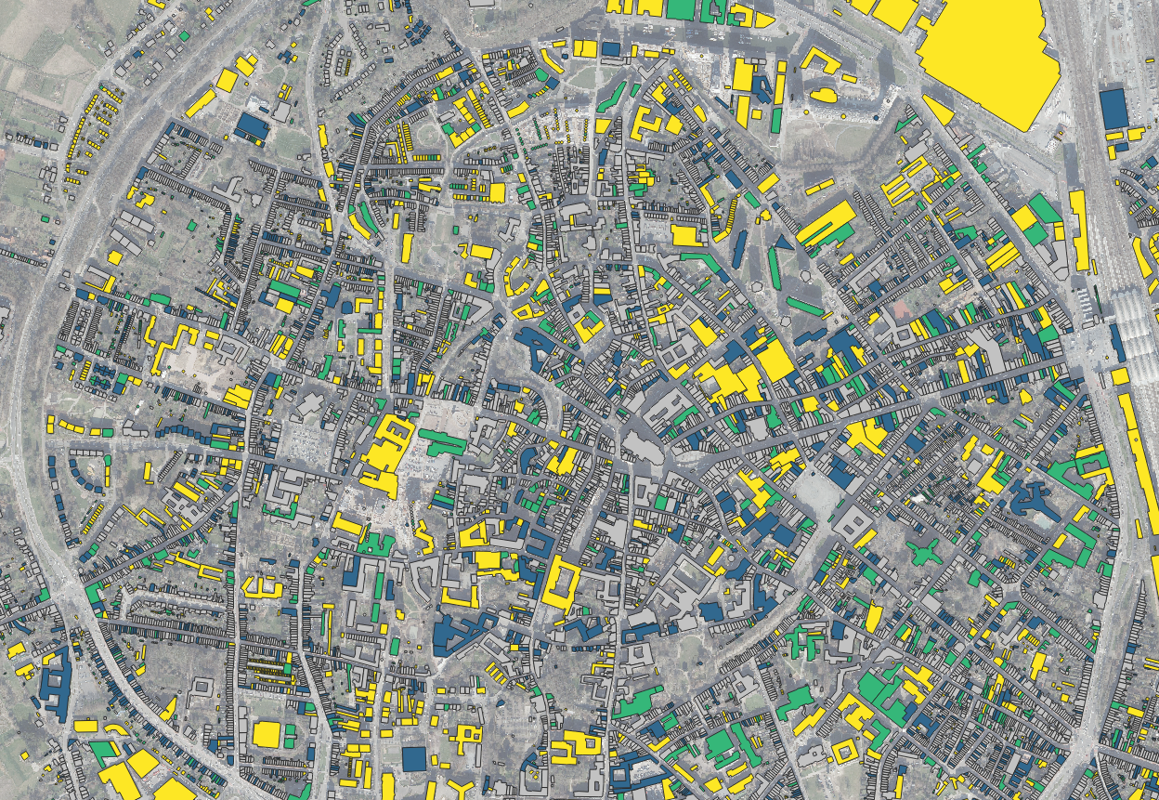
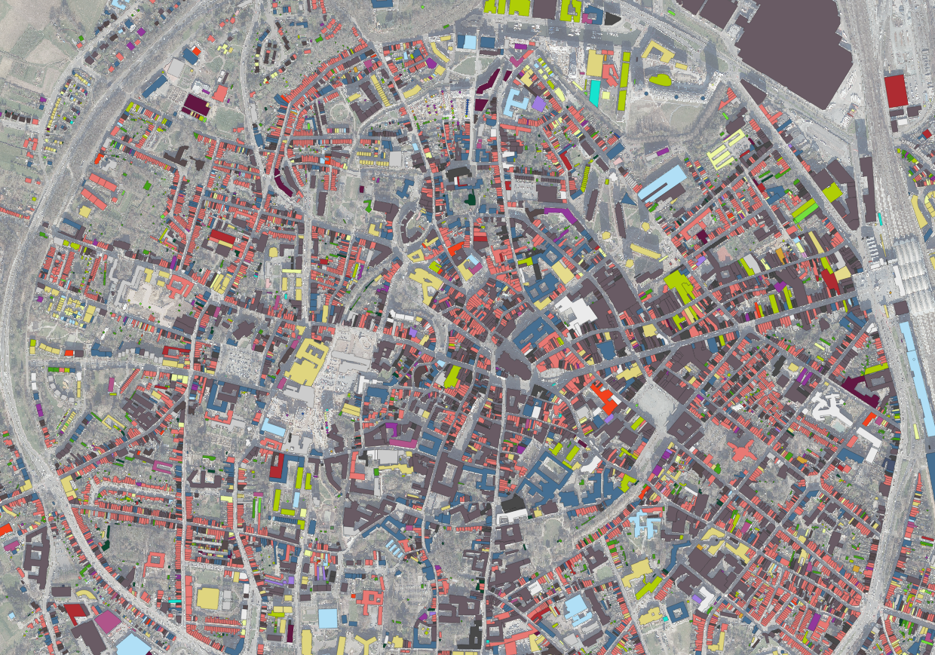
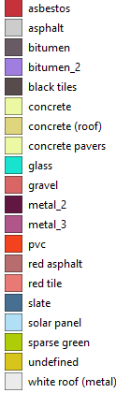
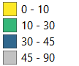
Overlay Analysis
Roof slopes
Roof materials

Slide 19
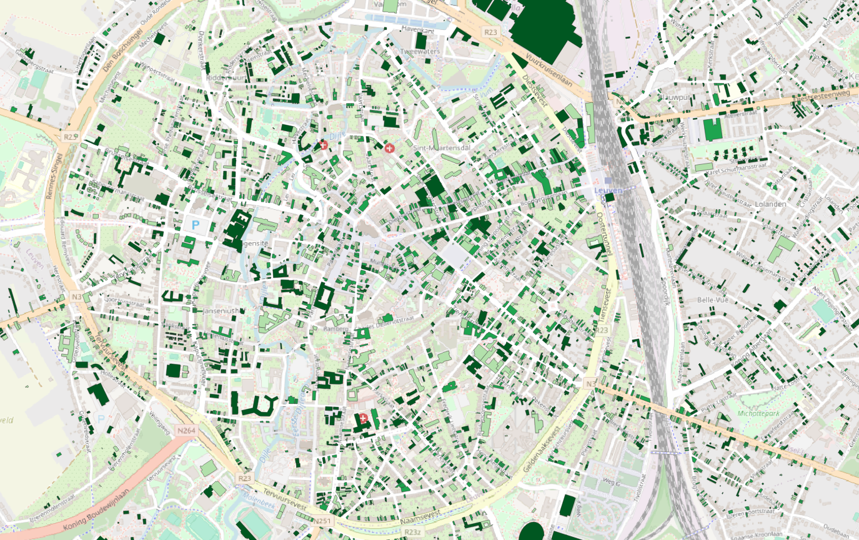
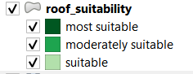
Green roof suitability
Selection criteria:
Surface material
Surface area
Roof slope

Slide 20
Source
These exercises are prepared using data from the Urban Data Spaces for the Green Deal project (USAGE)

